Slide 1
Drug Review Data Analysis
Chandrakanth Yadav Udari
Email: chandrakant@workwebmail.com

Slide 2
Contents
1) Introduction
2) Agenda
3) Data Understanding Phase
4) Data Preparation Phase
5) Exploratory Data Analysis
6) Data Modelling
7) Performance and Results
8) Conclusion

Slide 3
Introduction
The US has the largest pharmaceutical market in the world with a value of $339 billion USD. US prescription drug spending is expected to reach as high as $610 billion by 2021. Pfizer alone spent 7.6 billion dollars on R&D in financial year 2017. The growth is expected to accelerate in coming years. While these drugs are prescribed for their therapeutic properties, their use may result in unintended or adverse effects. There is a need for people to know the quality of drugs in this overcrowded market.
I plan to use Naïve bayes. Training on distinctive features machine learning algorithm. By evaluating the atypical features on different classifiers, it can be determined which features are the best for predicting the satisfaction rating with review as input.

Slide 4
Agenda
In this project we'll be working on Drug Prescription Reviews dataset having [uniqueID, drug Name, condition, review, rating, date, [useful Count] as features. We did preproces our data and did some exploratory data analysis in order to find out the Useful drugs, Useless Drugs. Also did Sentiment analysis using Reviews, Calculate the Effectiveness and Usefulness of Drugs, Analyzing the Medical Conditions and Finding Most Useful and Useless Drugs for each Condition
My project topic is to use various natural language processing techniques and machine learning algorithm to predict the satisfaction rating for a drug based on the reviews provided using python.

Slide 5
Data Understanding Phase
I have collected the dataset from kaggle
https://www.kaggle.com/datasets/rohanharode07/webmd-drug-reviews-dataset
The dataset provides user reviews on specific drugs along with related conditions, side effects, age, sex, and ratings reflecting overall patient satisfaction.
Data was acquired by scraping WebMD site. There are around 0.36 million rows of unique reviews and is updated till Mar 2020.
Inspiration This dataset intended to answer following questions:
Identifying the satisfaction rating sentiment of the patient based on drug reviews?
How to predict other rating based on patient’s reviews?
How to visualize drug rating, kind of drugs, types of conditions of patients (Visualizations)

Slide 6
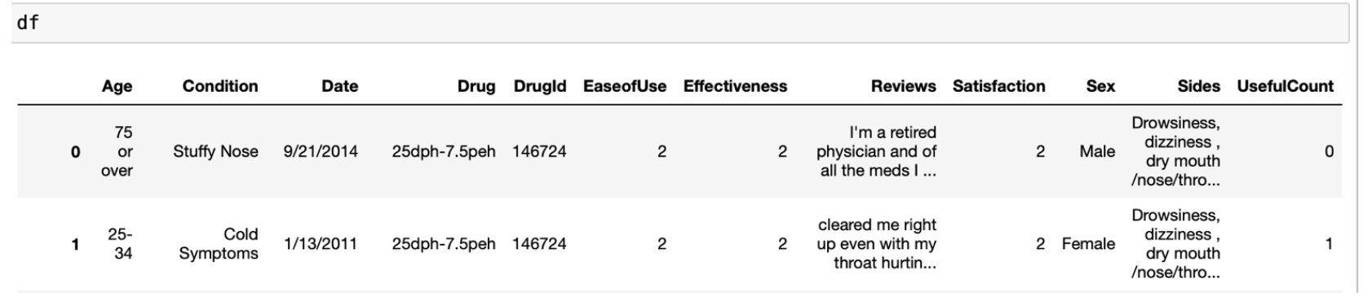
Data Understanding Phase

Slide 7
Data Understanding Phase
Drug (categorical): name of drug
DrugId (numerical): drug id
Condition (categorical): name of condition
Review (text): patient review
Side (text): side effects associated with drug (if any)
EaseOfUse (numerical): 5 star rating
Effectiveness (numerical): 5 star rating
Satisfaction (numerical): 5 star rating
Date (date): date of review entry
UsefulCount (numerical): number of users who found review useful.
Age (numerical): age group range of user
Sex (categorical): gender of user

Slide 8
Data Preparation Phase
This covers all activities to construct the final dataset from raw data. Data preparation tasks are likely to be performed multiple times and not in any prescribed order. Tasks include table, record, and attribute selection. It also includes transformation and cleaning of data for modeling tools. Fallacious data also needs to be excluded from our data. It involves handling of outliers. Outliers are data points that are much smaller or larger than the rest of the values in the dataset.
Data cleaning is a very crucial step in any machine learning model, but more so for NLP.
Without the cleaning process, the dataset is often a cluster of words that the computer doesn’t understand. Here, we will go over the steps done in a typical machine learning text pipeline to clean data.

Slide 9
Exploratory Data Analysis
Removing the null values
Removing the Nan values
Convert the text to lowercase:
Remove punctuation:
Remove stop words:
Stemming
Removing regular expressions
Creating Corpus
The other steps in cleaning the data could be removing URLs, HTML tags, emojis, numbers, etc.
I will also generate Word Cloud which is a data visualization technique used for representing text data in which the size of each word indicates its frequency or importance.

Slide 10
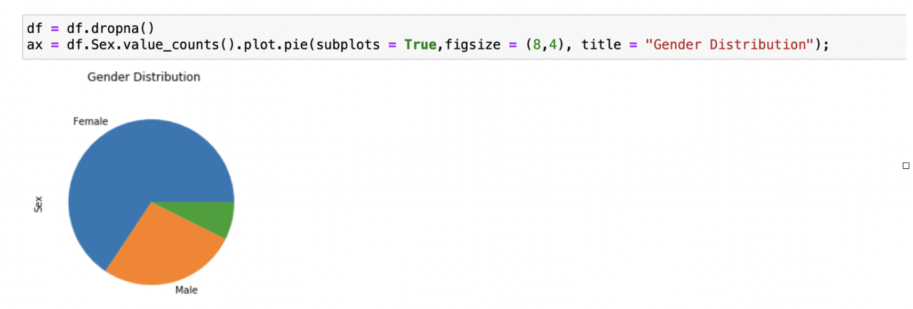
Exploratory Data Analysis
Exploratory Data Analysis (EDA) is an approach to analyze the data using visual techniques. It is used to discover trends, patterns, or to check assumptions with the help of statistical summary and graphical representations.
Gender Distribution:
This below graph shows gender distribution for whole data.

Slide 11
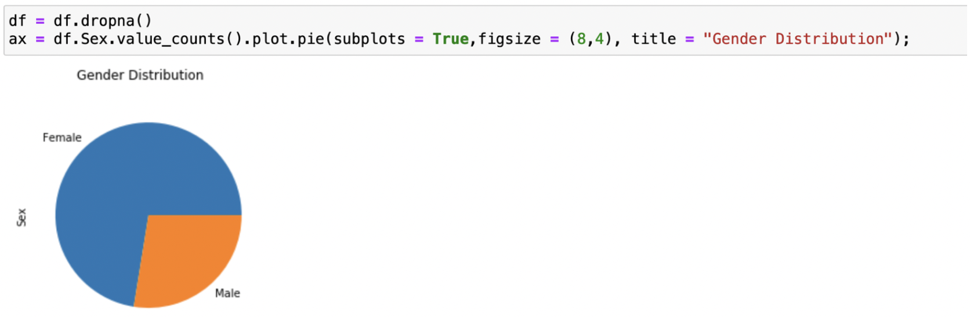
Exploratory Data Analysis
I’ve noticed that these values contain M, F and Nan values with empty spaces. Which is error in data, and I’ve removed it replacing with Nan value and then removing them. Then we can see only male and female in below graph,

Slide 12
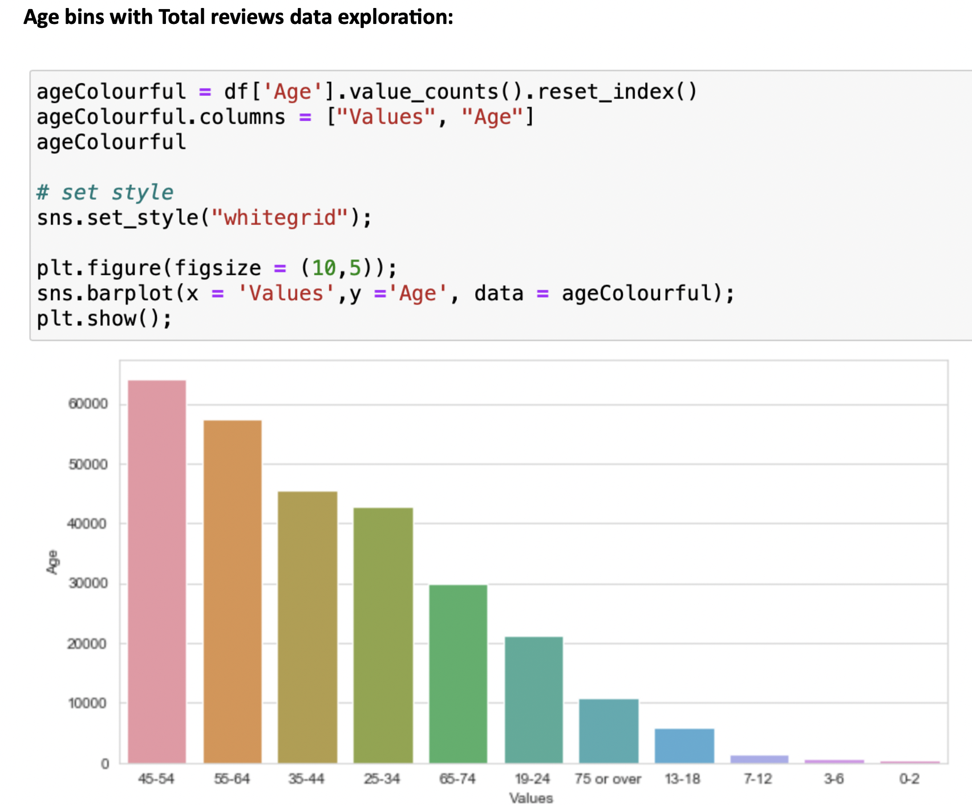
Exploratory Data Analysis

Slide 13
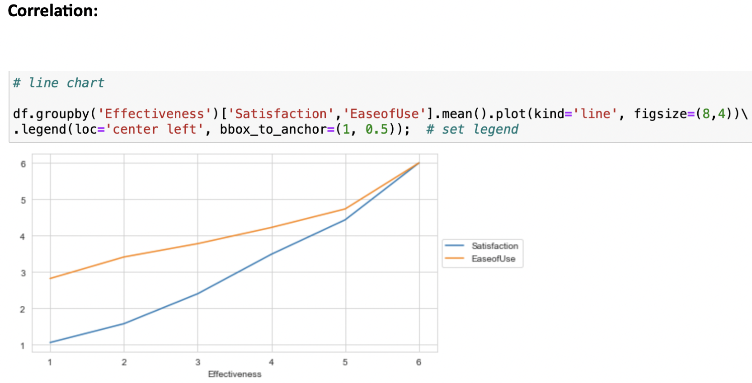
Exploratory Data Analysis
There is a very less correlation of ease-of-use to satisfaction rating as per this chart
But if we compare satisfaction rating with effectiveness rating , they are highly correlated.

Slide 14
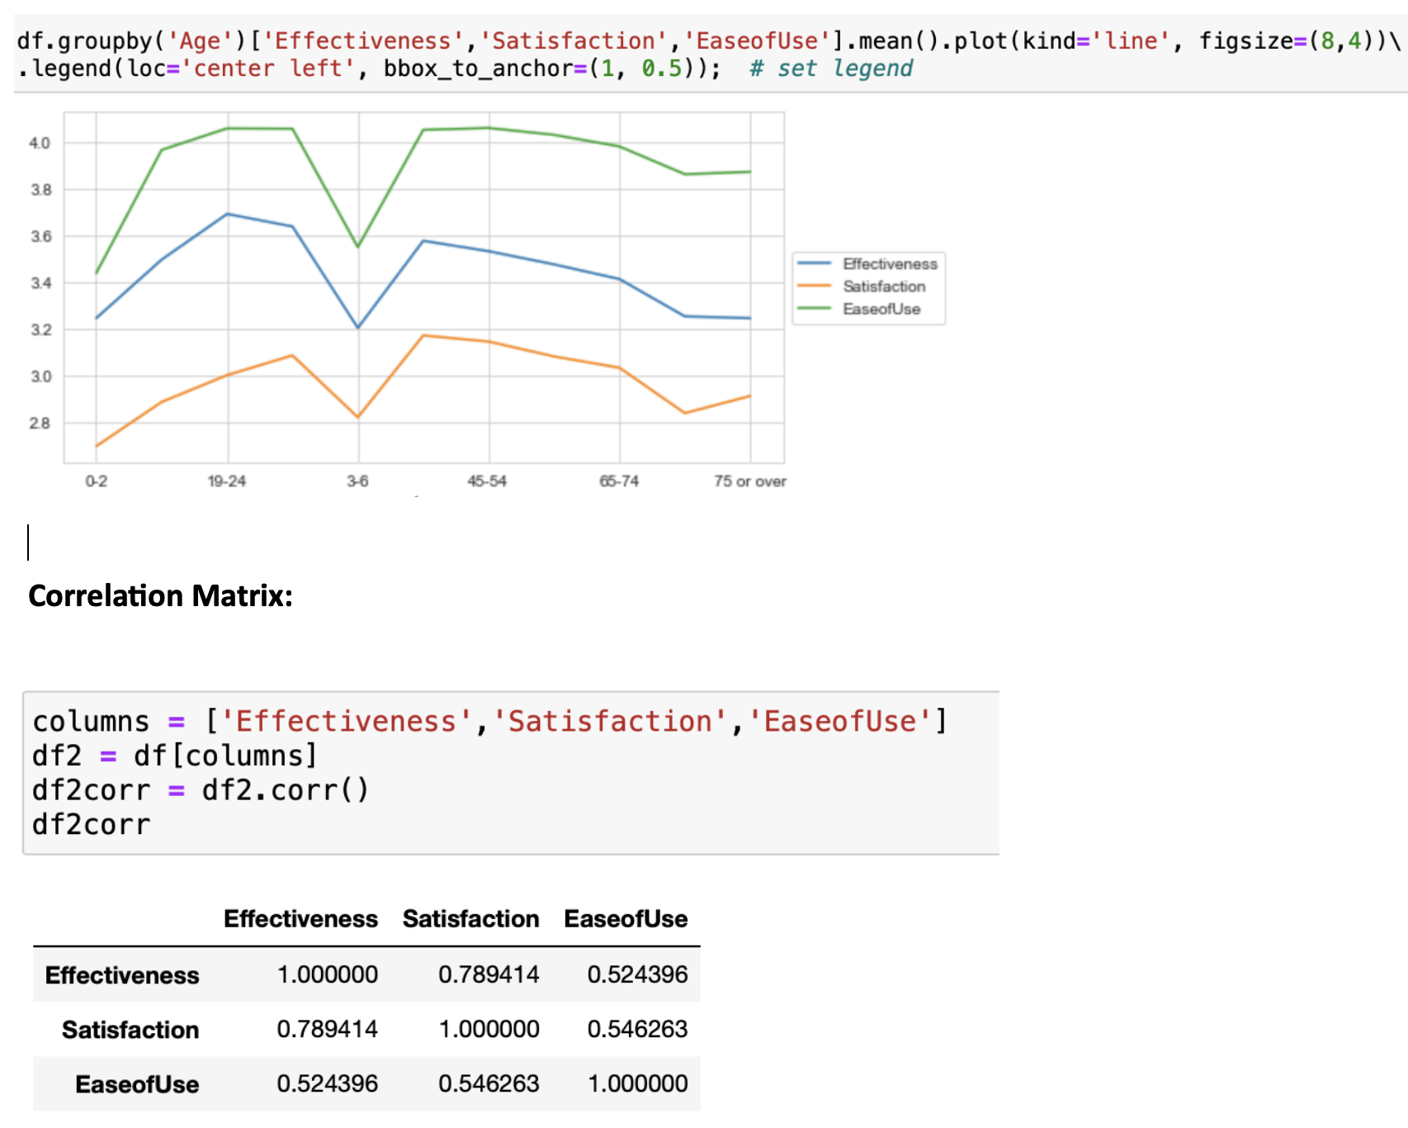
Exploratory Data Analysis

Slide 15
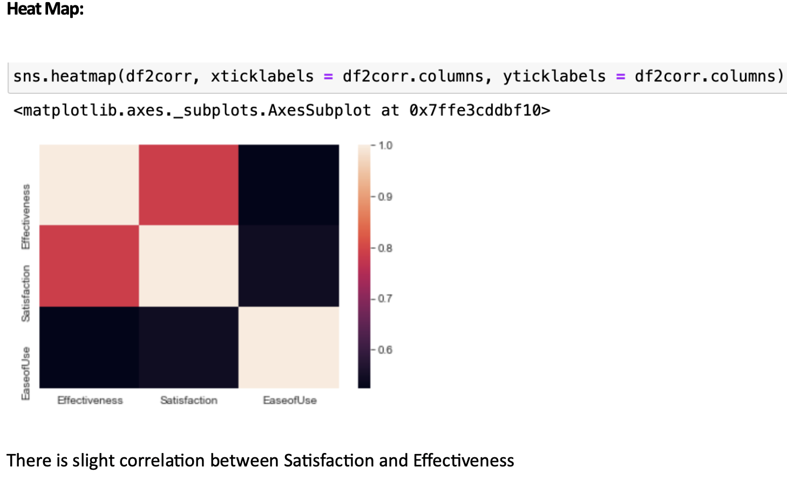
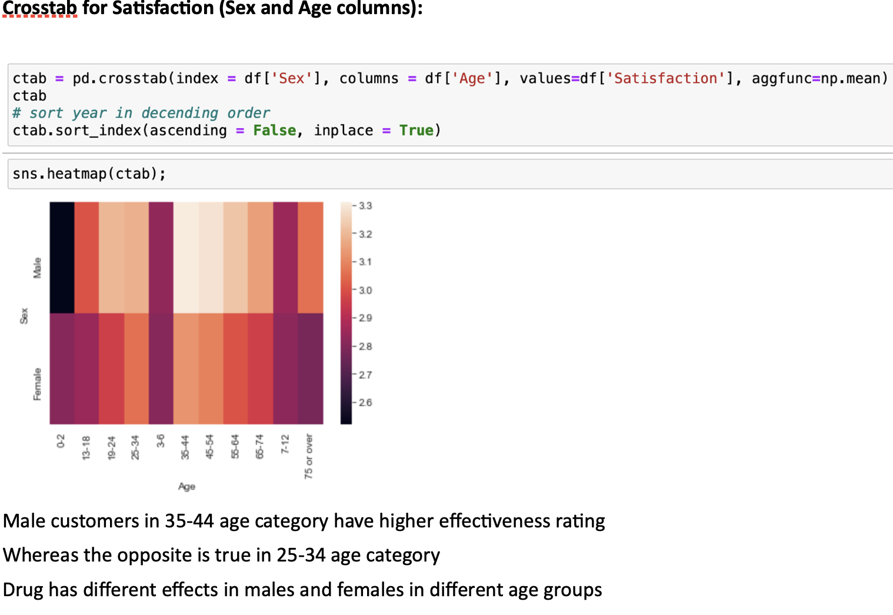
Exploratory Data Analysis

Slide 16
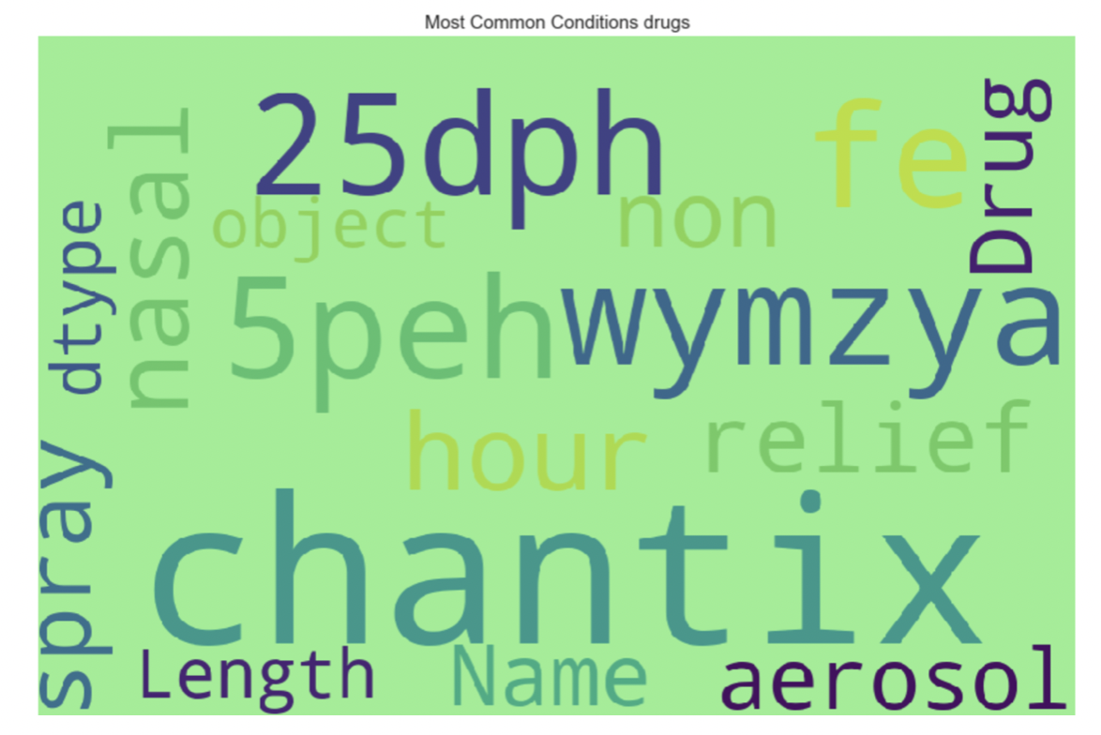
Exploratory Data Analysis
Word Cloud
Word Cloud is a data visualization technique used for representing text data in which the size of each word indicates its frequency or importance. Significant textual data points can be highlighted using a word cloud.
Word clouds are widely used for analyzing data especially dealing with NLP and text
The below word cloud is for the most common drugs

Slide 17
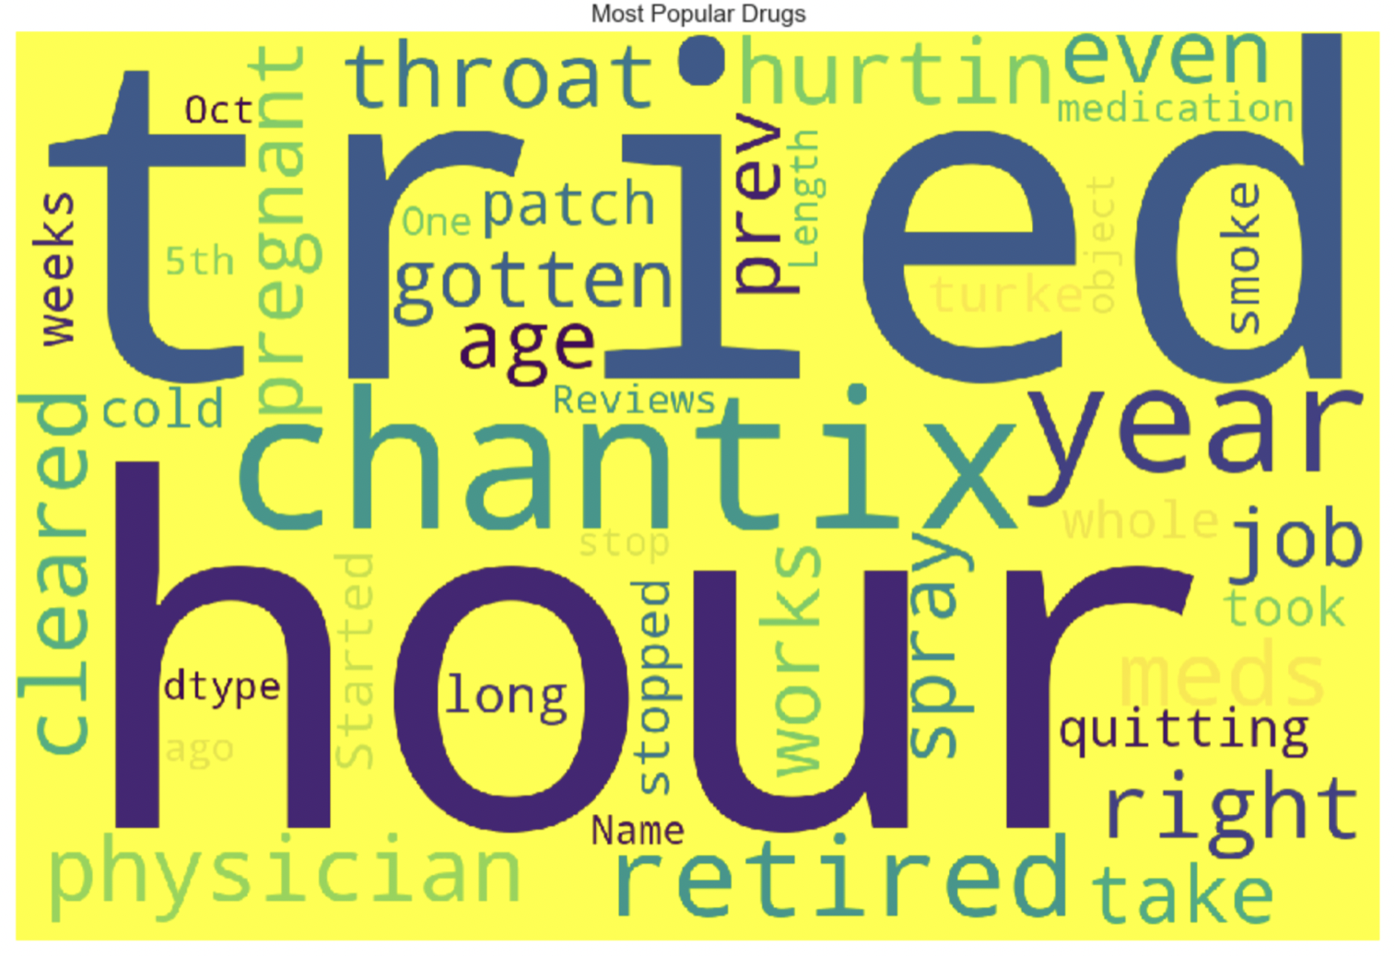
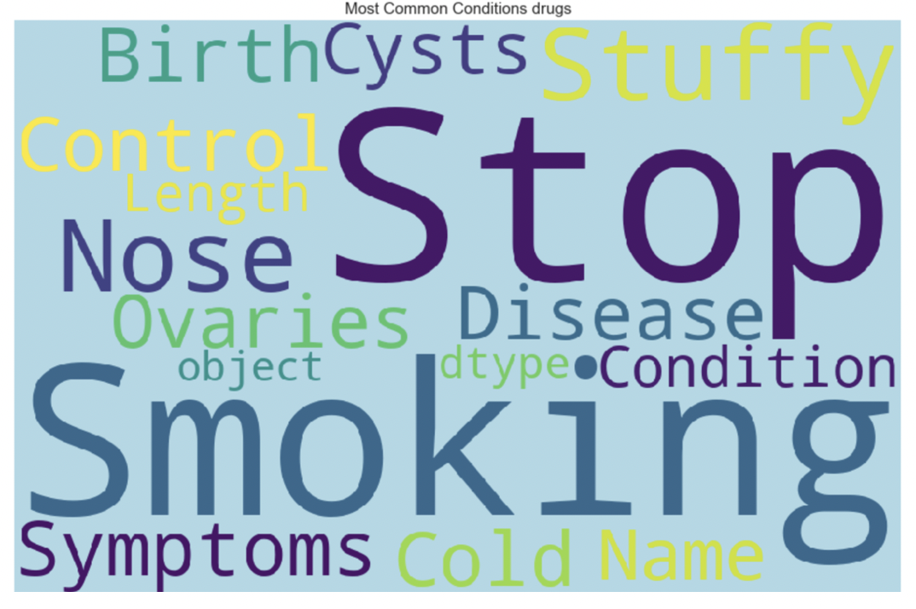
Exploratory Data Analysis

Slide 18
Data Modelling
In the Modelling phase, a suitable selection of modeling techniques, algorithms or combinations are done. After that, optimal algorithm parameter values are chosen
It is a technique based on Bayes’ Theorem with an assumption of independence among predictors. In simple terms, a Naive Bayes classifier assumes that the presence of a particular feature in a class is unrelated to the presence of any other feature
Machine learning algorithms build a model based on sample data, known as "training data", in order to make predictions or decisions without being explicitly programmed to do so. The performance of the fake news identification on the dataset was predicted by implementing machine learning algorithms. The algorithms used were:
.

Slide 19
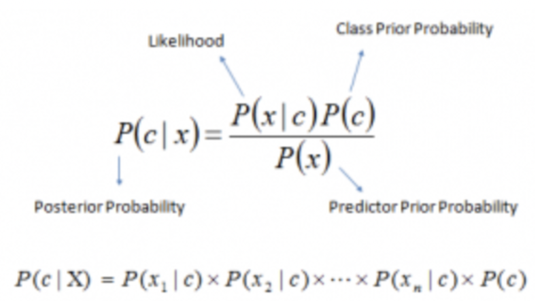
Data Modelling
Naive Bayes model is easy to build and particularly useful for very large data sets. Along with simplicity, Naive Bayes is known to outperform even highly sophisticated classification methods. Bayes theorem provides a way of calculating posterior probability P(c|x) from P(c), P(x) and P(x|c)
Above,
P(c|x) is the posterior probability of class (c, target) given predictor (x, attributes).
P(c) is the prior probability of class.
P(x|c) is the likelihood which is the probability of predictor given class.
P(x) is the prior probability of predictor.

Slide 20
Performance and Results
In the field of machine learning and specifically the problem of statistical classification as in our case, a confusion matrix, also known as an error matrix, is a specific table layout that allows visualization of the performance of an algorithm, typically a supervised learning one (in unsupervised learning it is usually called a matching matrix).
Each row of the matrix represents the instances in an actual class while each column represents the instances in a predicted class, or vice versa. The name stems from the fact that it makes it easy to see whether the system is confusing two/multi classes (i.e., commonly mislabeling one as another). The following are the interpretations from the confusion matrix.
1. True Positive: You predicted positive and it’s true
2. True Negative: You predicted negative and it’s true.
3. False Positive: You predicted positive and it’s false.
4. False Negative: You predicted negative and it’s false.

Slide 21
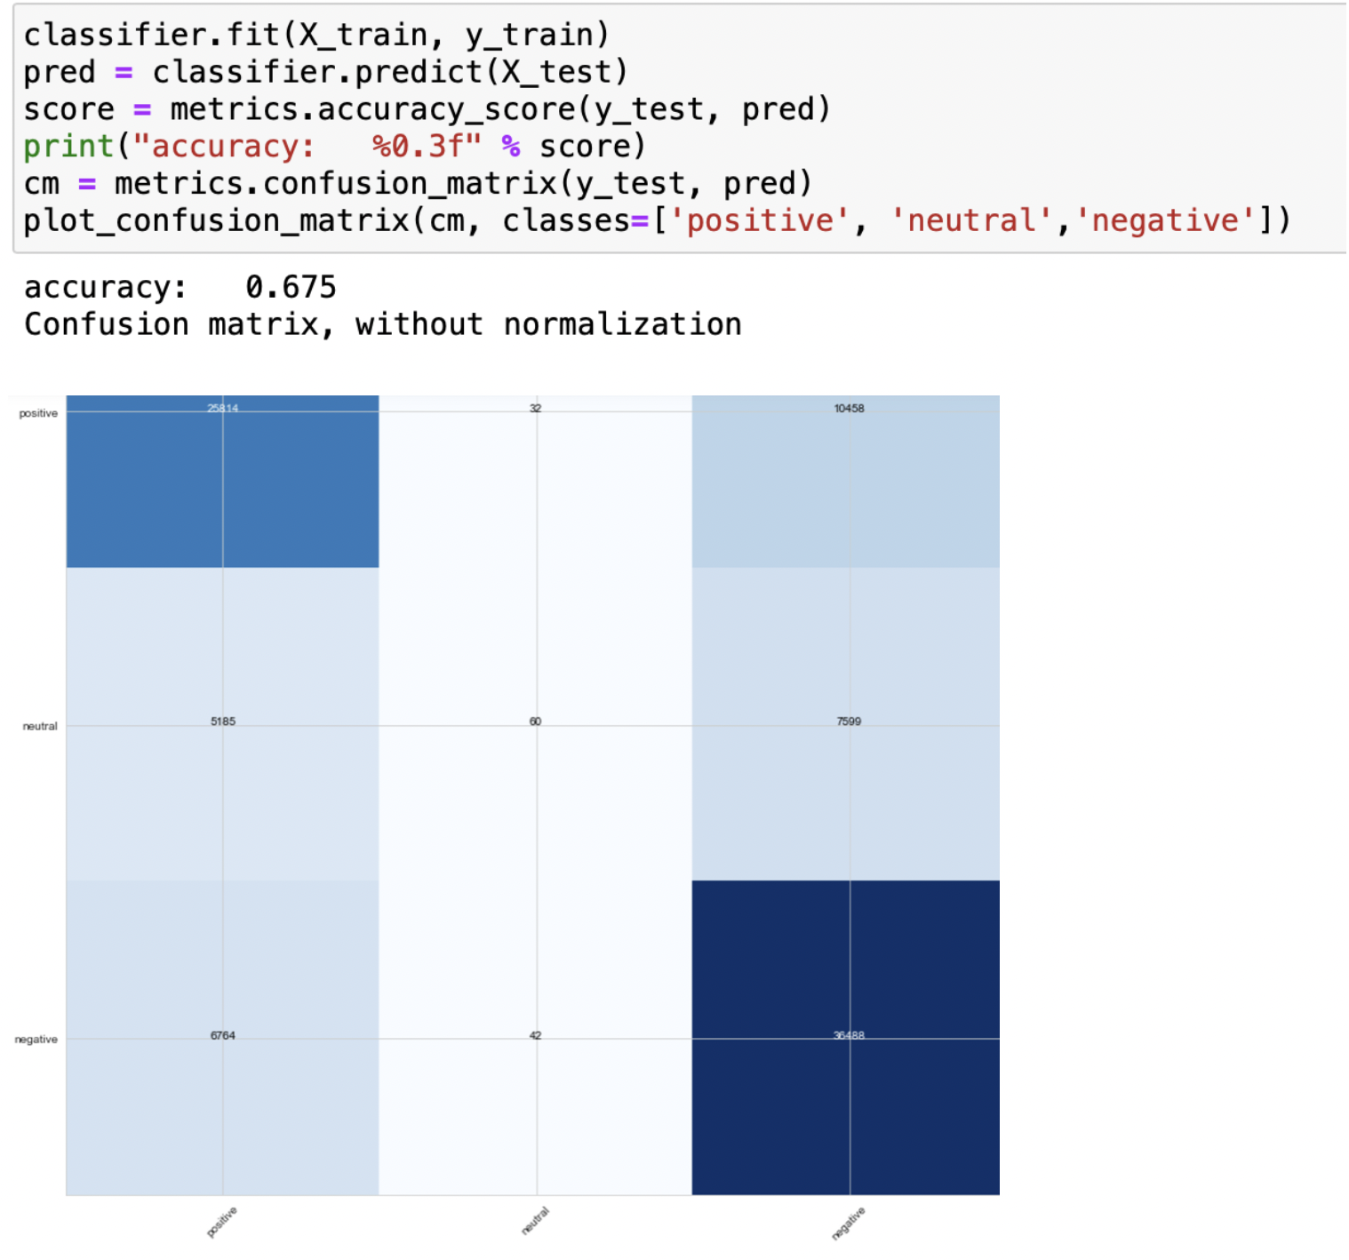
Performance and Results
This phase involved checking the efficiency of the model. This is done by dividing our data into training and testing data before applying the model. The tasks performed under evaluation phase is to check the accuracy of our model on testing data. If the accuracy of the model is not up to the mark, alternative models can be deployed. In our case, the model should accurately classify the news into fake news and true news once the models achieve the required accuracy. The following is the evaluation as well as categorization of the results.

Slide 22
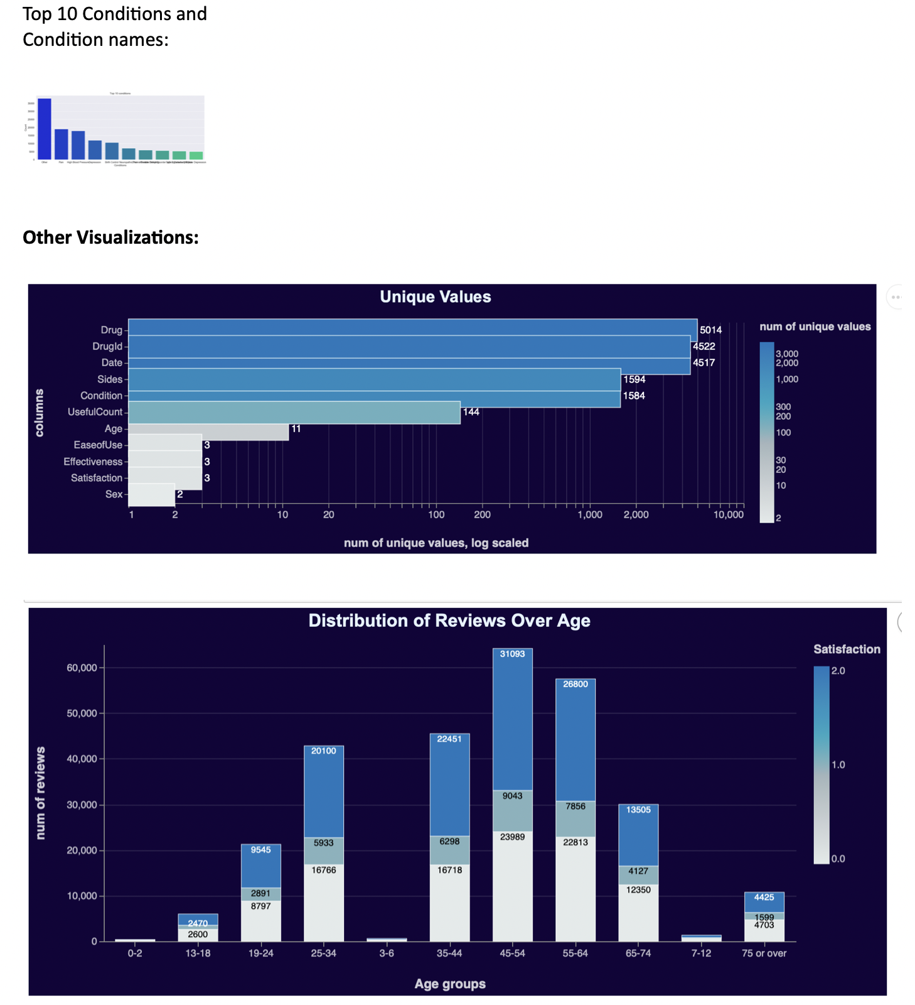
Performance and Results

Slide 23
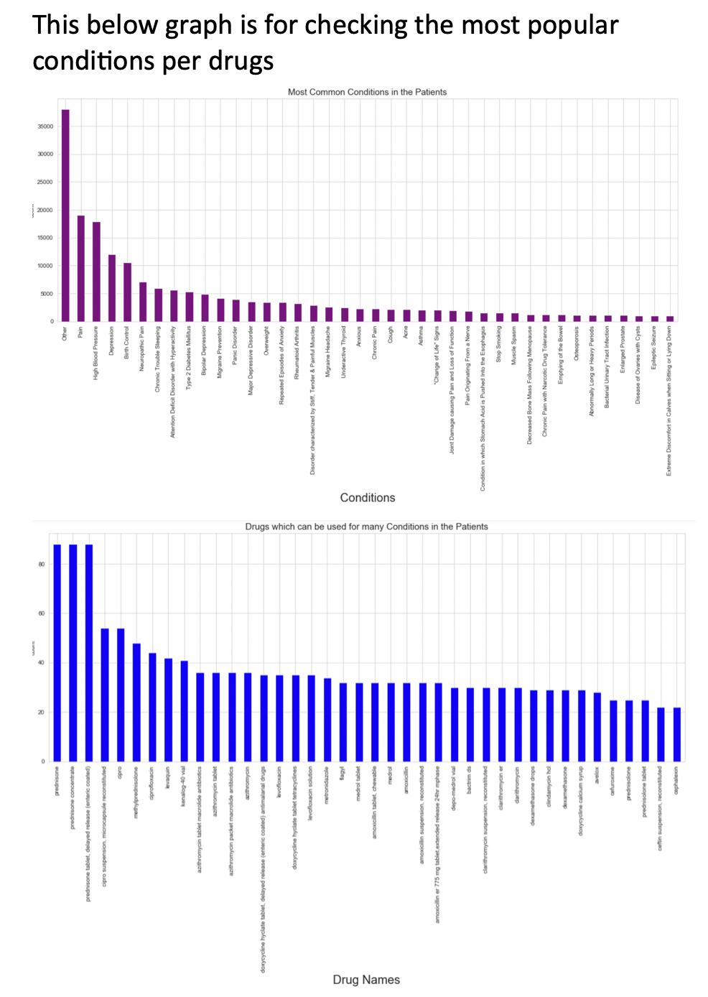
Performance and Results

Slide 24
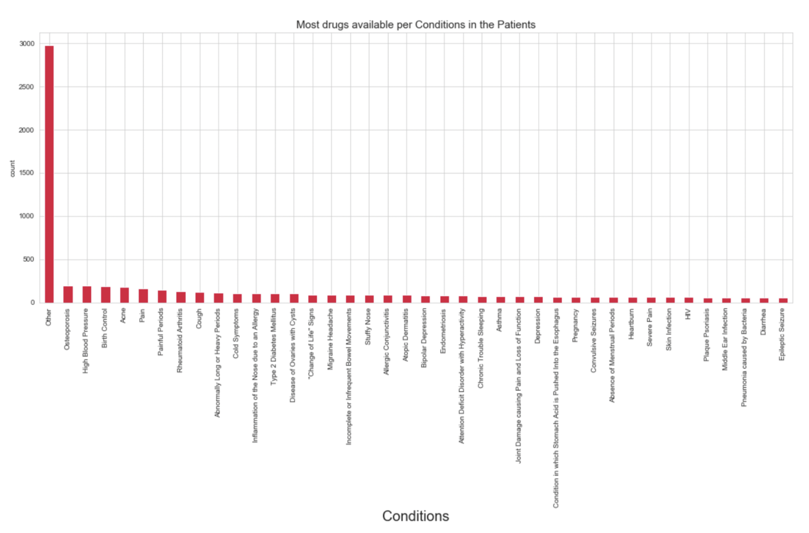
Performance and Results

Slide 25
Conclusion
Goals: Based on the selected topic we can do Data Visualization and Analysis, Text preprocessing, NLP, TF-IDF, Naïve Bayes Classifier
The US has the largest pharmaceutical market in the world. If anyone wants to buy a drug, WebMD is the largest website in terms of page views and clicks. It is assumed to be a legitimate source of information. I decided to use the data from the website regarding the reviews posted by the patients or caretakers on the website. It will give us a good overview of a particular drug if we get the sentiment analysis in the reviews. WebMD is an organization which provides information, support and reference material about health subjects through a team of doctors and health experts across a broad range of specialty areas.
The main objective of this notebook was to perform sentiment analysis on the reviews to predict if the reviewer was satisfied with the drug he or she rated or not. Sentiment analysis (also known as opinion mining or emotion AI) refers to the use of natural language processing, text analysis, computational linguistics, and biometrics to systematically identify, extract, quantify, and study affective states and subjective information

